Slide 1
File Systems
Unit 4

Slide 2
What is a File System?
Collection of on-disk structures & algorithms
Sometimes, in-core & on-disk vary
Generally at Kernel level
Sometimes at User-mode level
Basic file functions
Sometimes advanced
Generally on disk
Sometimes on other permanent media & volatile media

Slide 3
History
File systems were considered part of the OS
DEC Tape (184 kilobytes per tape on the PDP-8)
1972, Gary Kildall
Working on PL/M
Created CP/M (3 ½ K, 8 characters, 3 extension)
Digital Research
usage of CP/M was tripling every year.
Tim Patterson
“QDOS” (Quick and Dirty Operating System)
16-bit CP/M
Bill Gates bought Tim Patterson’s QDOS for $50,000
Renamed it MS-DOS
FAT name was coined

Slide 4
What exactly is a File System?
An Abstraction
Persistent Storage
It allows data to stored for long term
Hierarchical Namespace
It identifies data by names (filenames)
It provides large namespace (path)
APIs
It provides clean interface to manipulate data

Slide 5
But how it WORKS?
Example of FAT32 file system
It consists of 4 different parts
BOOT Sector
FAT (File Allocation Table)
Directory Structure
Clusters

Slide 6
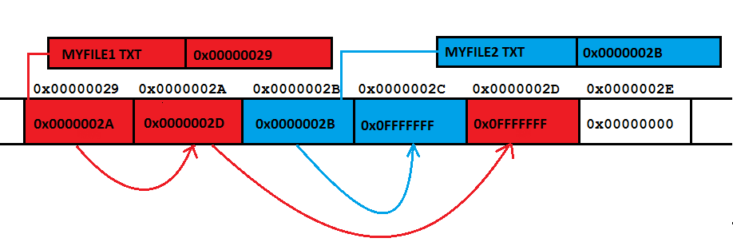

Slide 7
OK! Then how it works!!!
Kernel code checks for volumes
Uses Entries in PT & signatures in Boot sector to identify the type
Loads appropriate code (ALGORITHMS)
This code mounts the file system at some specific point (Drive in Win, Folder in *nix)
Creates in-core structures to map on-disk structures

Slide 8
File System Structure
fopen(“c:\abc\abc.txt”)
Directory Module
File Module
Access Control Module
File Access Module
Block Module
Device Module
Maps File Names to File IDs
Maps File IDs to actual files
Validates the access
Reads & Writes Data/Metadata
Allocates & Accesses Disk Blocks
Disk I/O, I/O level caching

Slide 9
Distributed File Systems
Unit 4

Slide 10
What is DFS?
It is a client/server-based application that allows clients to access and process data stored on the server as if it were on their own computer.
What about FTP?
User gets copy of the file!
Needs to know address of the server!!
Is it a concrete file system?
Generally NO!!!

Slide 11
DFS - goals
Goal:
To provide common view of centralized file system, but distributed implementation.
Ability to open & update any file on any machine on network
Handle all synchronization issues and capabilities of shared local files
Thus, the goal is to manage a set of dispersed storage devices to look & work like one.

Slide 12
DFS - Requirements
Basically only two:
access transparency, and
location transparency
However, other requirements have become mandatory;
performance,
scalability,
concurrency control,
fault tolerance, and
security

Slide 13
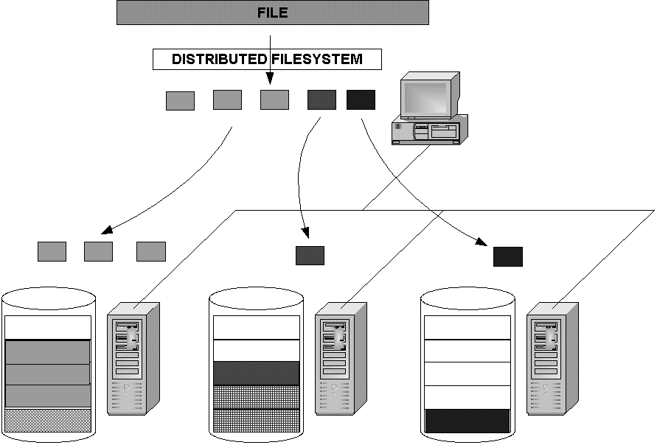
Client Computer
Servers may be running 3 different concrete file systems (FAT, ext4, LFS) on top of which DFS runs
Server 3
Server 1
Server 2

Slide 14
What about naming?
3 schemes:
combination of host and local name
guarantees a unique name
But NOT location transparent & location independent.
DFS is a loose collection of independent file systems.
E.g. Windows Network
Mount remote directories to local directories
Coherent directory structure & location independent
E.g. Unix/Linux with NFS; Windows with mapped drives
Total integration of component file systems.
A single global name structure spans all the files in the system.

Slide 15
A Comparison
Sharing
Persistence
Distributed
Consistency
Example
cache/replicas
maintenance
Main memory
1
RAM
File system
1
UNIX file system
Distributed file system
Sun NFS
Web
Web server

Slide 16
File Service
A file service is a specification of what the file system offers to clients.
A file server is the implementation of a file service and runs on one or more machines.

Slide 17
Dis. FILE SERVICE REQUIREMENTS
Unit 4

Slide 18
DISTRIBUTED File Service Requirements
Transparency
Concurrency
Replication
Heterogeneity
Fault tolerance
Consistency
Security
Efficiency

Slide 19
Transparency
Access:
Local/Remote file should be accessed in the same manner
Mobility:
Automatic relocation of files should be possible
Location:
Same namespace after relocation of files
Performance:
Programs should continue to perform satisfactorily
Scaling:
Expanding the service to meet additional loads should be transparent

Slide 20
Concurrency
File-level or record-level locking
Other forms of concurrency control

Slide 21
Replication
For better load-sharing & response, multiple identical copies of files may be maintained

Slide 22
Heterogeneity
Service can be accessed by clients running on (almost) any OS or hardware platform.
Design must be compatible with the file systems of different OSes
Service interfaces must be open
precise specifications of APIs are published.

Slide 23
Fault tolerance
Service must continue to operate even when clients make errors or crash.
Service must resume after a server machine crashes.
If the service is replicated, it can continue to operate even during a server crash.

Slide 24
Consistency
Unix offers one-copy update semantics for operations on local files.
Single cached copy
Difficult to achieve the same for distributed file systems while maintaining good performance and scalability.
Multiple caches (performance)
Multiple physical copies (scalability & reliability)

Slide 25
Security
Must maintain access control and privacy as for local files.
based on identity of user making request
Identities of remote users must be authenticated
Privacy requires secure communication
Service interfaces are open to all processes not excluded by a firewall.
vulnerable to impersonation and other attacks

Slide 26
Efficiency
Goal for distributed file systems is to perform comparable to local file system.

Slide 27
Dis. FILE SERVICE COMPONENTS
Unit 4

Slide 28
DISTRIBUTED File Service COMPONENTS
Structuring the file service as three components:
A flat file service
A directory service
A client module.

Slide 29
DISTRIBUTED File Service COMPONENTS
Client computer
Server computer
Application
Directory service
Application
Flat file service
Client module

Slide 30
Flat File Service
Concerned with the implementation of operations on the contents of file.
Unique File Identifiers (UFIDs) are used to refer to files in all requests for flat file service operations.
UFIDs are long sequences of bits chosen so that each file has a unique number among all of the files in a distributed system.

Slide 31
Directory Service
Provides mapping between text names for the files and their UFIDs.
Clients may obtain the UFID of a file by quoting its text name to directory service.
Directory service supports functions needed generate directories, to add new files to directories.

Slide 32
Client Module
It runs on each computer and provides integrated service (flat file and directory) as a single API to application programs.
For example, in UNIX hosts, a client module emulates the full set of Unix file operations.
It holds information about the network locations of flat-file and directory server processes.

Slide 33
Dis. FILE SERVICE TYPES
Unit 4

Slide 34
File Models
Structured vs Unstructured
Un-Structured – Stream of bytes
Structured - Stream of records
Mutable vs Immutable
In-place updates
Out-of-place updates

Slide 35
File Accessing Models
Remote Service Model
Data-Caching Model
Cache consistency problem
Upload/Download Model

Slide 36
Data Transfer Models
File-Level Transfer
Block Level Transfer
Record Level Transfer
Byte Level Transfer

Slide 37
OTHER DFS design considerations
Unit 4

Slide 38
CACHE CONSISTENCY
Reduce network traffic by retaining recently accessed disk blocks in local cache
In memory cache
Small files, diskless workstations
In disk cache
Large files, sustains server failure
Cache-consistency problem
keeping the cached copies consistent with the master file, especially on write operations

Slide 39
Cache update
Write through
Reliable but hinders performance
Delayed-write
Write operations complete quickly;
some data may be overwritten in cache, saving needless network I/O.
Poor reliability
unwritten data may be lost when client machine crashes
Inconsistent data
Solution: scan cache at regular intervals and flush dirty blocks

Slide 40
SERVER SEMANTICS
Stateless Service
Avoids maintaining state information in server by making each request self-contained.
No need to establish and terminate a connection by open and close operations.
Poor support for locking or synchronization among concurrent accesses
E.g. NFS

Slide 41
SERVER SEMANTICS
Stateful Service
Client opens a file (as in Unix & Windows).
Server fetches information about file from disk, stores in server memory,
Returns to client a connection identifier unique to client and open file.
Identifier used for subsequent accesses until session ends.
Server must reclaim space used by no longer active clients.
Increased performance; fewer disk accesses.

Slide 42
REPLICATION
Replicas of the same file reside on independent machines.
Improves availability and can shorten service time.
Naming scheme maps a replicated file name to a particular replica.
Existence of replicas should be invisible to higher levels.
Replicas must be distinguished from one another by different lower-level names.
Updates
Replicas of a file denote the same logical entity
Update to any replica must be reflected on all other replicas.

Slide 43
AN IMPLEMENTATION
Unit 4

Slide 44
SUN-NFS : A Distributed file system
Developed by Sun Microsystems in the 1980s to allow any computer to access files residing on any other computer connected via a network.
The motivation
share files across heterogeneous machines.
The design goal
provide this service without having to modify, or even recompile, programs accessing these files.
In addition, Unix file access semantics and reasonable performance had to be ensured.

Slide 45
SUN-NFS : Architecture
It consists of three software components:
one that resides on top of some concrete file system (such as UFS) on the server and exports directories as NFS shares to clients;
another that hooks to the Virtual File System (VFS) on the client machine to abstract the NFS share on the server as a local concrete file system;
and finally, the communication protocol between the NFS server and NFS client.

Slide 46
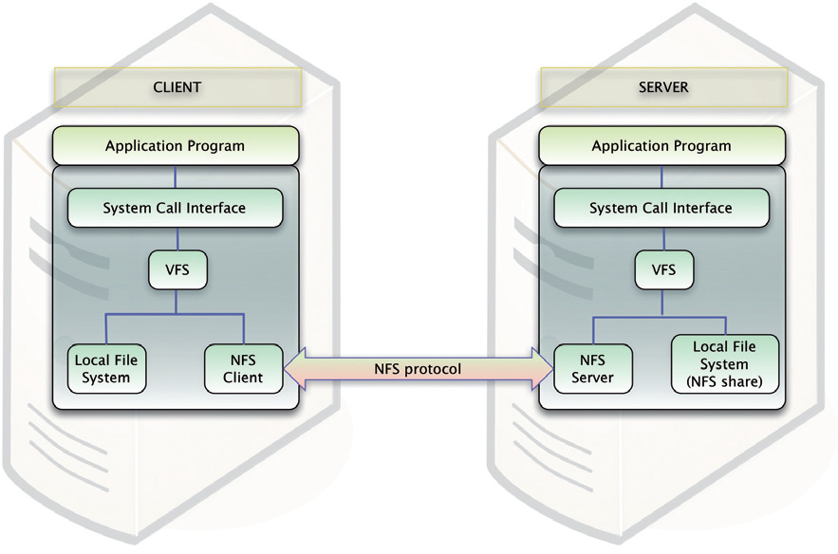
SUN-NFS : Architecture

Slide 47
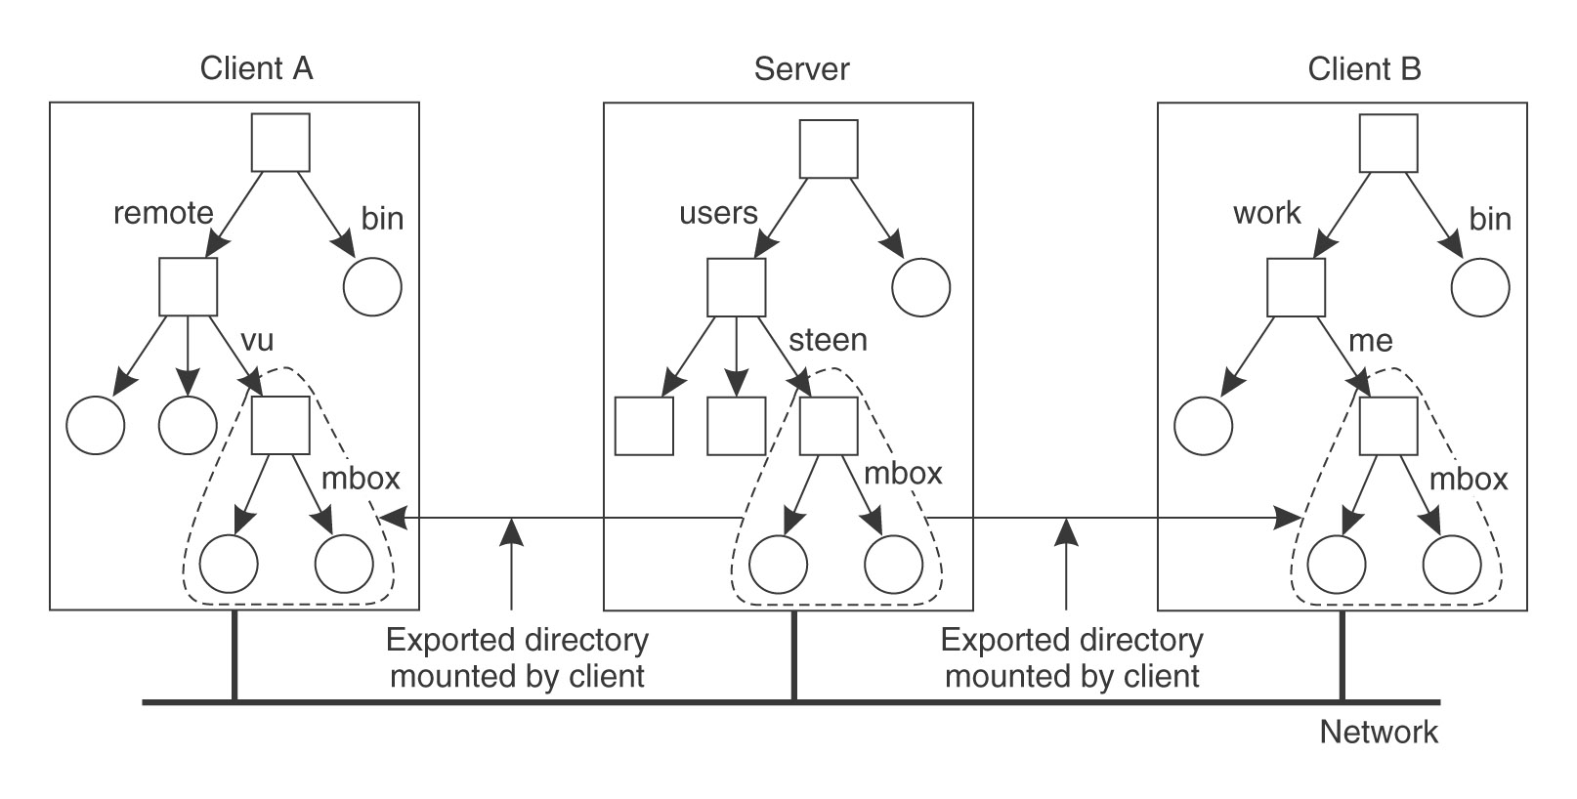
SUN-NFS: AN EXAMPLE
Server A sees : /users/ steen/mbox
Client A sees: /remote/vu/ mbox
Client B sees: /work/me/ mbox

Slide 48
References
Books:
Distributed systems: principles and paradigms by AST & MV Steen
Distributed OS (Concepts & Design) by PK Sinha
Papers:
A SURVEY OF DISTRIBUTED FILE SYSTEMS by M. Satyanarayanan
The design & implementation of SUN NFS by Sandberg et al.
Understanding and mitigating security issues in Sun NFS by Wasim A.B. & S.M.K. Quadri

